Slide 1

From reactive to predictive: Anomaly Detection in Robotic Arms using Deep Learning
Student Name: Gokul Thillainathan
Student ID: C00313519
Supervisor name: Milu Philip

Slide 2
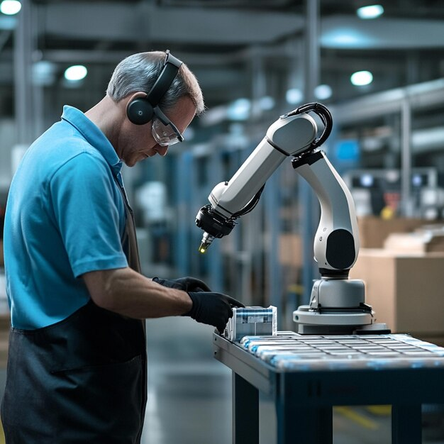
Brief summary of dissertation
Collaborative robots are increasingly used in critical production environments where even minor mechanical deviations can lead to downtime or safety risks.
This dissertation proposes a real-time anomaly detection framework using LSTM and GRU Autoencoders to monitor joint-level behavior from multivariate sensor data.
The models are trained on operation data, detect deviations based on reconstruction errors, and are validated using synthetic anomalies for proactive fault awareness.

Slide 3
Study Contribution & Research Gap
Research Gap
Existing models focus mostly on global TCP deviations, ignoring joint-level degradations critical to early fault detection.
Most approaches lack domain-aware interpretation without mapping them to mechanical tolerances.
Lack of labelled fault data in real-world scenarios is rarely addressed using synthetic faults effectively.
Prior comparisons between LSTM and GRU often omit runtime trade-offs and anomaly sharpness detection.
Objective
Develop an anomaly detection model to identify industrial robot joint deviation based on differences analysis among target and actual position, velocity, and current.
Design and implement an LSTM-based Auto-encoder architecture to model healthy joint behavior and detect temporal deviations indicative of early-stage faults in collaborative robots.
Design and implement a GRU-based Auto-encoder architecture for the same anomaly detection task, optimizing for runtime efficiency and reduced model complexity compared to LSTM.
Compare the performance of LSTM-AE and GRU-AE models

Slide 4
Methodology
Data Collection & Integration:
1. Dataset Source: Public NIST benchmark for UR5e cobot executing a repeated trajectory.
2. Sensors Monitored: Joint-level values for position, velocity, and current over thousands of cycles.
3. Format: Multivariate time-series data collected per joint.
4. Segmentation: Each joint's data treated independently for model training and testing.
Cleaning & Standardizing:
1. Removed symbolic or non-numeric noise.
2. Normalized features using MinMaxScaler to scale between 0 and 1.
3. Trimmed inactive segments (where velocity = 0) to focus on motion-relevant windows.
Feature Engineering:
1. Selected features: Target vs Actual values of Position, Velocity and Current
2. Constructed input sequences using a sliding window of 50 timesteps.
3. Each input shape structured as (50 timesteps × 5 features) for time-dependent learning.

Slide 5
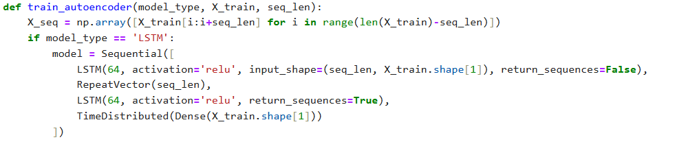
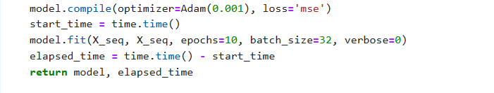
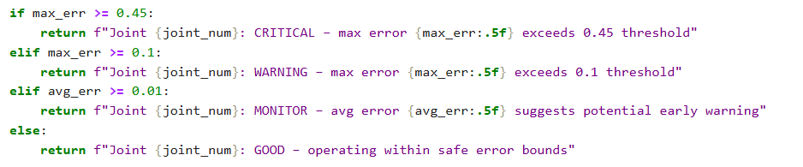
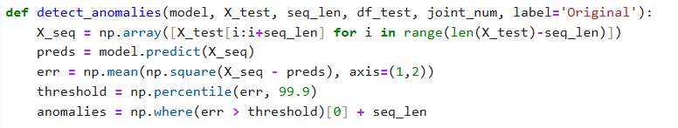
Model Implementation

Slide 6
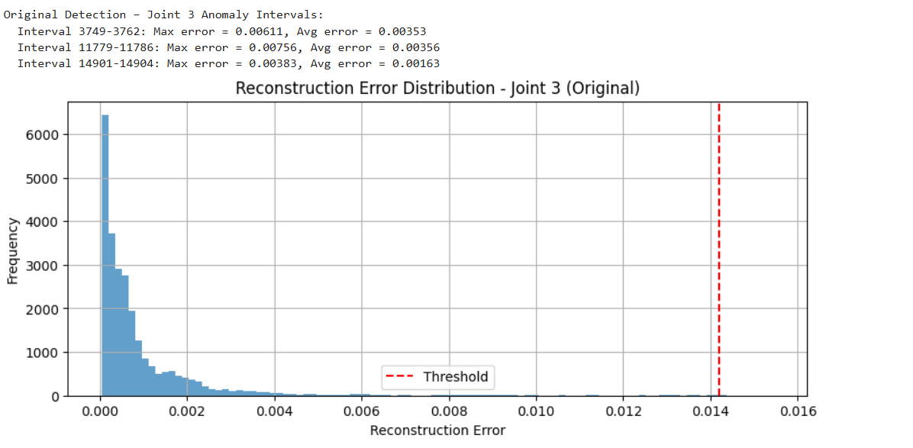
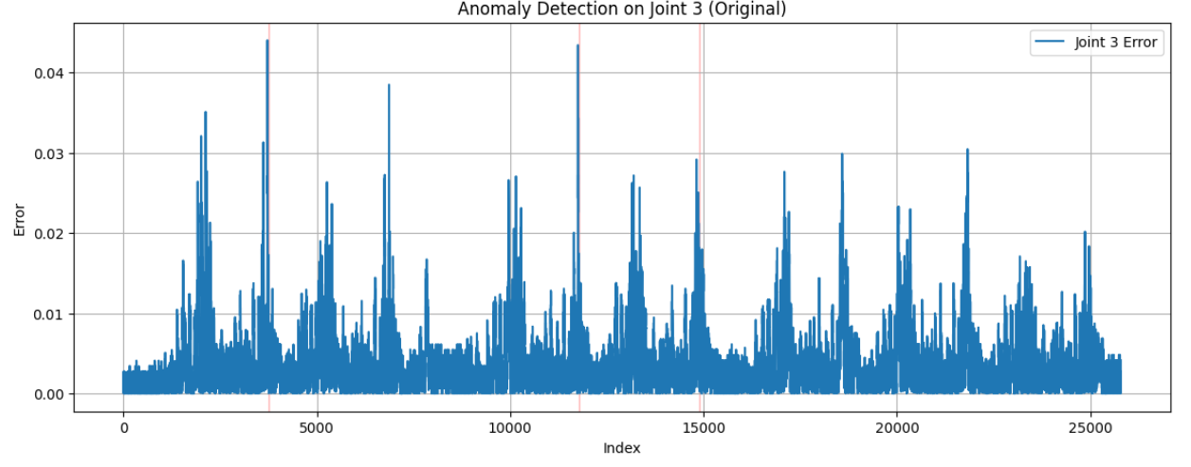
Findings – LSTM Model
LSTM model trained on all 6 joints independently using 5 features over 50-timestep sequences.
Reconstruction error distribution (top) shows most sequences fall within a narrow normal range.
99.9th percentile threshold used to identify outliers as anomalies.
Histogram reveals only rare high-error sequences are flagged.
On Joint 3, three distinct intervals were detected with abnormally high reconstruction error.

Slide 7
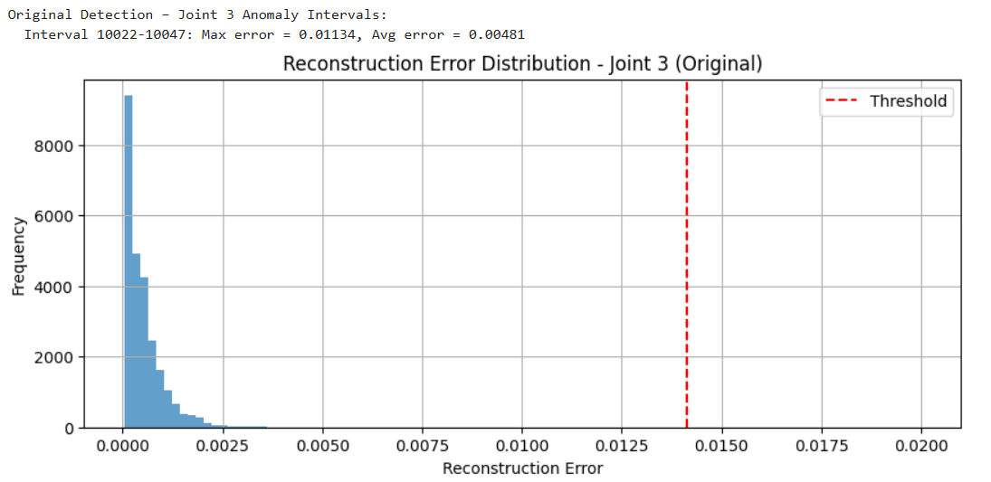
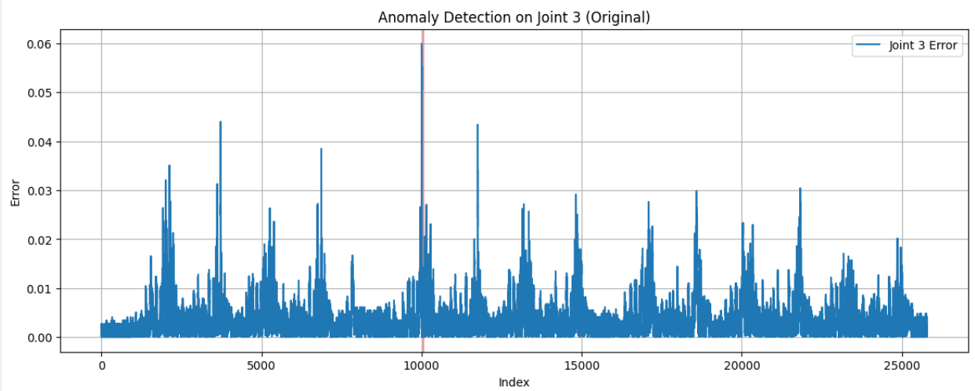
Findings – GRU Model
GRU model trained on the same dataset and structure as the LSTM, ensuring equal evaluation conditions.
Input: multivariate time-series for all 6 joints; Joint 3 shown here.
Reconstruction error distribution shows tighter clustering than LSTM, with lower maximum error.
Threshold based on 99.9th percentile used to isolate outliers.
GRU detected only 1 anomaly interval on Joint 3 — indicating lower sensitivity to short transients.

Slide 8
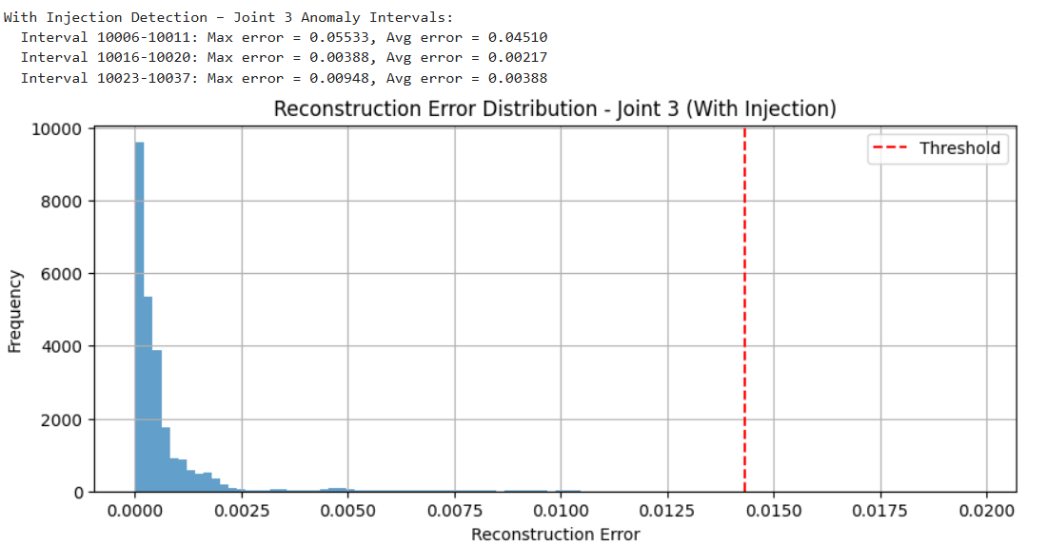
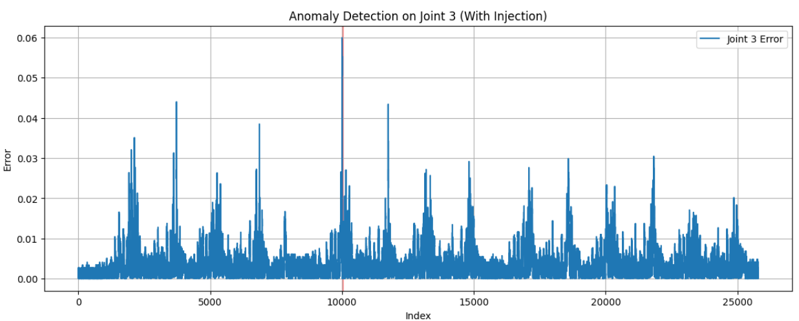
Evaluation – LSTM Model
Synthetic anomaly injected into Joint 3 in the interval near Index 10000 to simulate degradation.
No labelled fault data was available; injection used to verify model detection capability.
LSTM model retrained on original data and tested on the modified dataset.
Clear spike observed in reconstruction error during the injected interval.
Model successfully flagged the anomaly — confirming reliable detection under synthetic fault conditions.

Slide 9
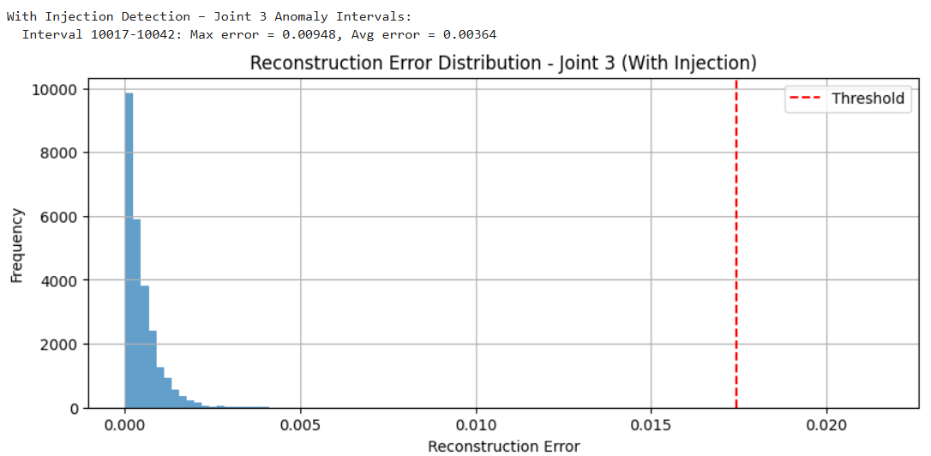
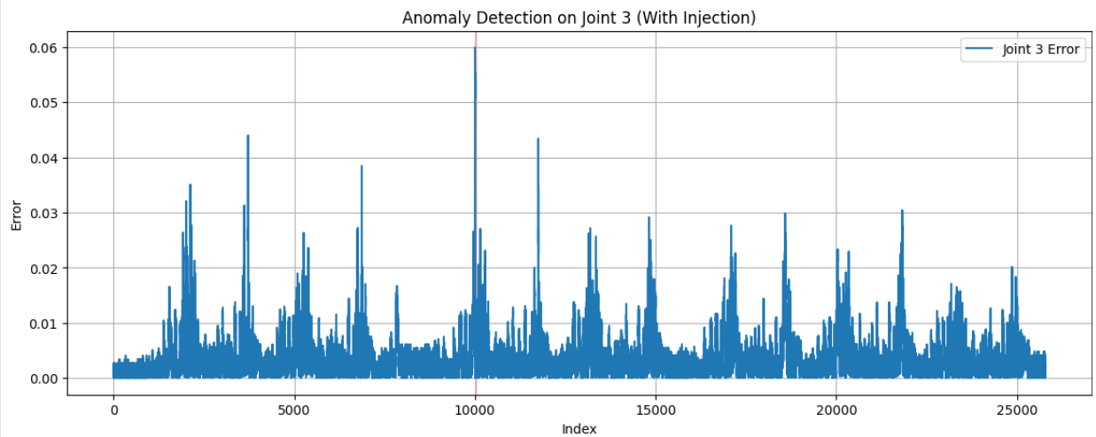
Evaluation – GRU Model
Synthetic anomaly injected into Joint 3 at index 10000–10010 with a +0.05 deviation.
GRU model retrained on normal dataset and evaluated on the modified test set.
Despite lower error than injection value, the spike exceeded GRU’s statistical threshold (99.9%).
Histogram shows a distinct tail post-injection, confirming successful detection.
GRU appears to capture temporal drift more than abrupt spikes.

Slide 10
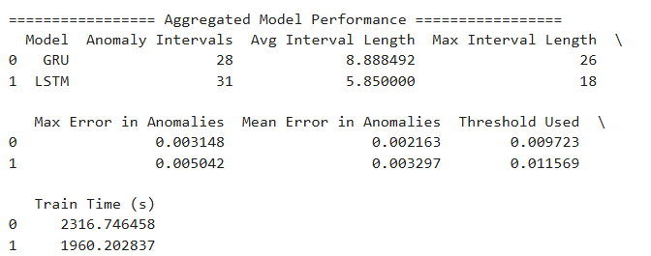
Discussion & Model Comparison
LSTM is more reactive, detecting brief, sharp anomalies with higher sensitivity.
GRU provides smoother detection over longer intervals, showing better temporal consistency.
GRU’s lower threshold and tighter error range make it more robust in noisy environments.
LSTM is suitable for detecting early warning spikes. GRU is better for monitoring degradation phases.
GRU also offers faster training, making it more scalable for edge or real-time deployments.
Model choice depends on the application: high-alert sensitivity (LSTM) vs. runtime efficiency and stability (GRU).

Slide 11
Conclusions and recommendations
Conclusion:
LSTM and GRU Autoencoder models were successfully developed and tested on real robot joint sensor data.
Both models effectively detected early deviations, even when joints remained within domain thresholds.
LSTM: higher sensitivity to sharp, short-term anomalies.
GRU: more stable detection of sustained faults with lower false positives.
Deep learning models showed clear advantages over traditional rule-based methods.
Recommendations:
Deploy models in real-time industrial environments using robotic controllers or edge devices.
Implement online learning or concept drift adaptation to keep models reliable over time.
Expand input data using multi-sensor fusion (e.g., torque, vibration, temperature).
Extend from detection to fault-type classification and severity estimation for smarter maintenance decisions.

